Slide 1
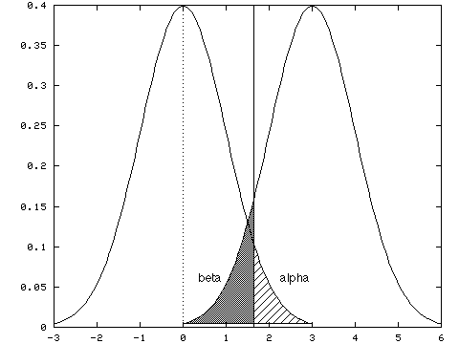
Week 6: Tests of difference; Midterm reflections
Geog4300: Shannon

Slide 2
This week
Hypothesis testing
One- and two-sample tests of difference

Slide 3

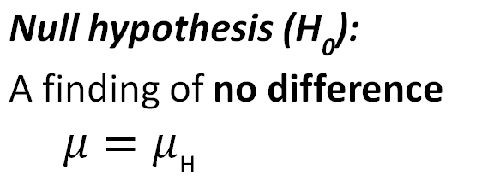
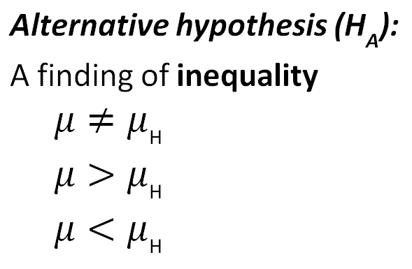
Ingredients of classical hypothesis testing
Notes:
Alternative hypothesis is usually what you’re trying to prove.

Slide 4
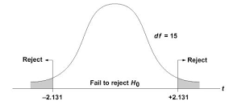
Reject or fail to reject?
Based on test results, we reject or fail to reject the null hypothesis.
We don’t prove or disprove it, but show it is likely or unlikely to be true.
Notes:
Alternative hypothesis is usually what you’re trying to prove.

Slide 5
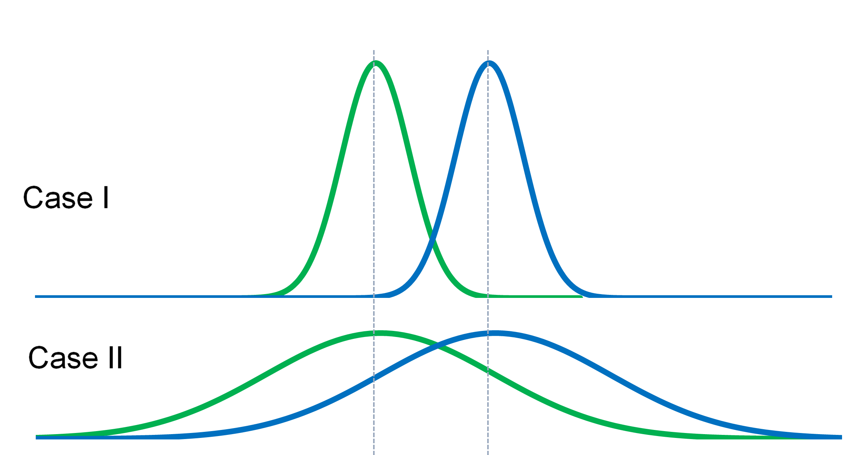
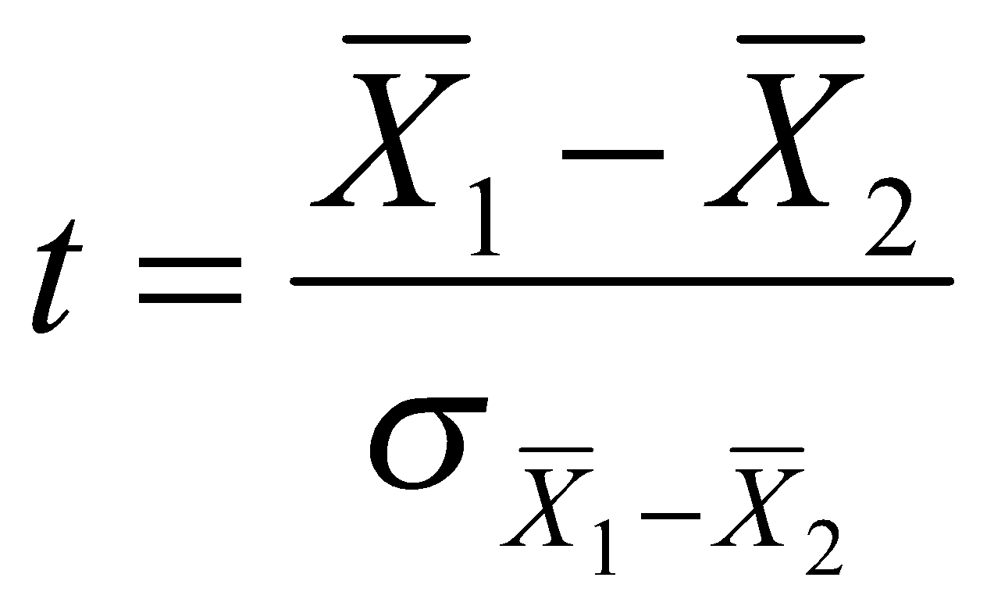
Tests of difference
Is there a difference between two groups?

Slide 6
Tests of difference
What is the specific purpose of this test? When would you use it rather than another one?
One sample t-test
Two sample t-test with equal variance
Two sample t-test with unequal variance
Two sample paired t-test
Difference between two proportions

Slide 7
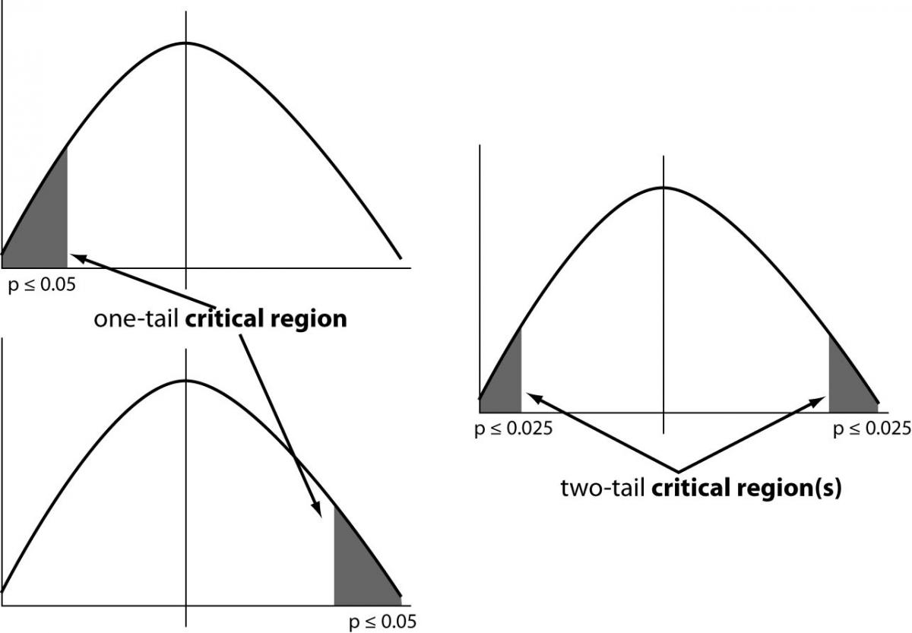
Interpreting results
Is this a one-tailed or two-tailed test?
Is the result above/below the critical value for significance?
P < 0.05:
These results are only possible in <5% of all possible samples in which the two means are equal.

Slide 8
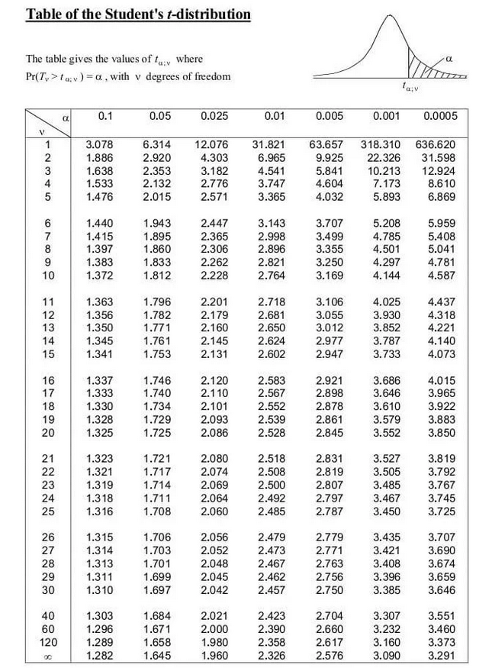
Interpreting results
Is this a one-tailed or two-tailed test?
Is the result above/below the critical value for significance?
Degrees of freedom:
Unequal variances:
the smaller of n₁-1 or n₂-1
Equal variances: n₁+n₂-2

Slide 9
What’s the critical value?
Sample 1: 12 observations
Sample 2: 14 observations
Two situations:
Variances equal and a two-tailed test
Variances unequal and a one-tailed test
Degrees of freedom:
Unequal variances:
the smaller of n₁-1 or n₂-1
Equal variances: n₁+n₂-2

Slide 10
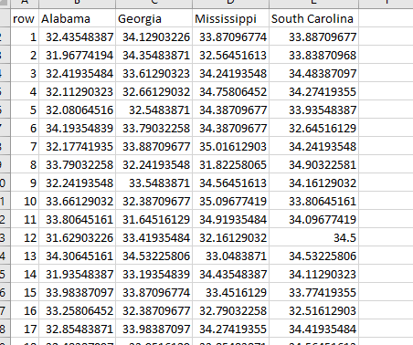
Let’s try it in Excel!
Was it hotter in Georgia or Alabama in July 2015?
Sample of 30 counties from each state using Daymet data:
Daymet_SEStates_July2015.csv

Slide 11
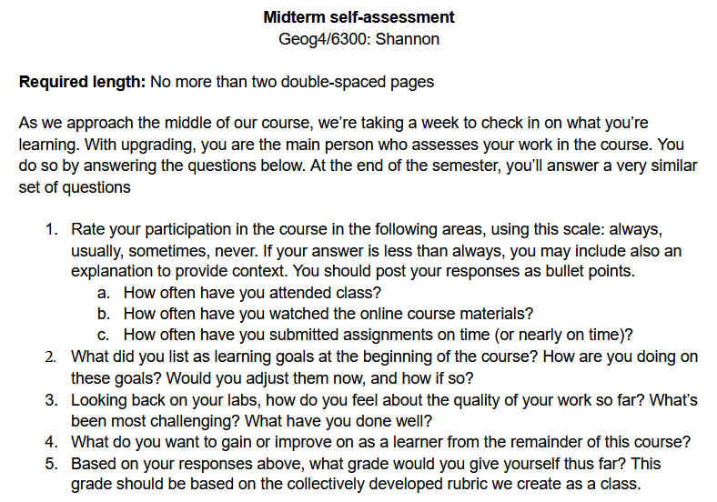
About the midterm
What have you learned so far?
Assignment link
Class rubric

